Slide 2
1,500 BC

Slide 3
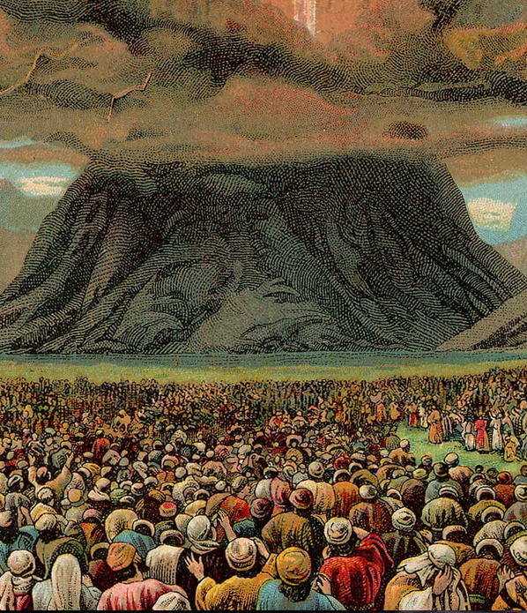

Slide 4
Deuteronomy 4: 9-20

Slide 5
Congregation Assembly

Slide 6
500 BC

Slide 7
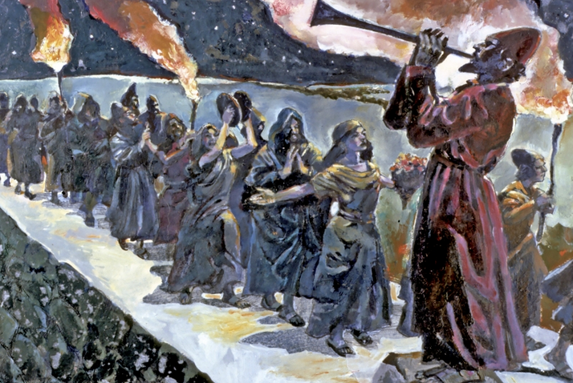

Slide 8
Nehemiah 13: 1-3

Slide 9
200 BC

Slide 10
LXX ‘Septuagint’ The Hebrew Bible translated into Greek before 200BC

Slide 11
Synagogue Ecclesia

Slide 12
54 AD

Slide 13
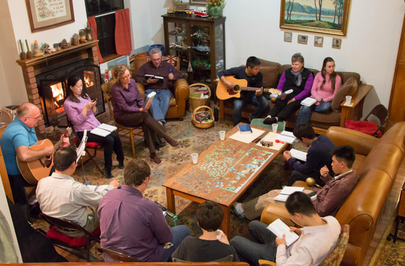

Slide 14
I Corinthians 1:1-10

Slide 15
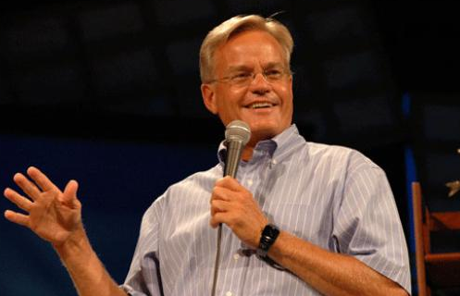
Bill Hybels

Slide 16
350 AD

Slide 17
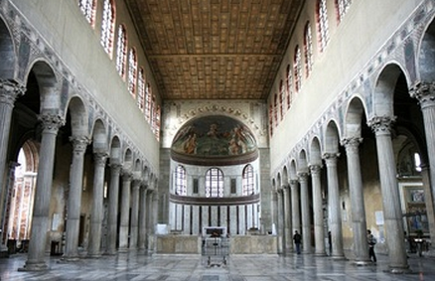
Santa Sabina Basilica, Rome
Built in 422 AD

Slide 18
Ecclesia Church

Slide 19
1600 AD

Slide 20
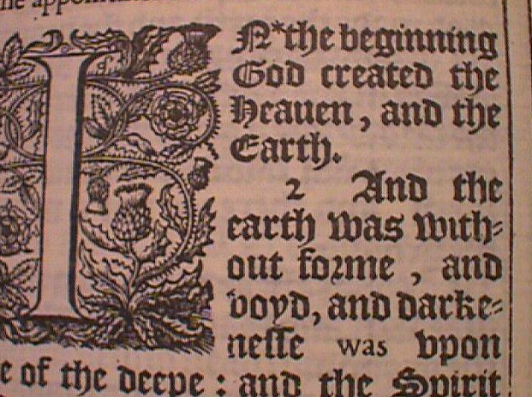

Slide 21
Ecclesia = ‘Assembly’, congregation Church = The Lord’s House, the Institution

Slide 22
Summary. Our Church is: 1) a continuation of the Assembly of Israel 2) called by Jesus to break down walls, and be the hope of the world! 3) warned against idolatry and taking ourselves too seriously

