Slide 1
h.greenhalgh@xtra.co.nzh.greenhalgh@xtra.co.nz

Slide 2
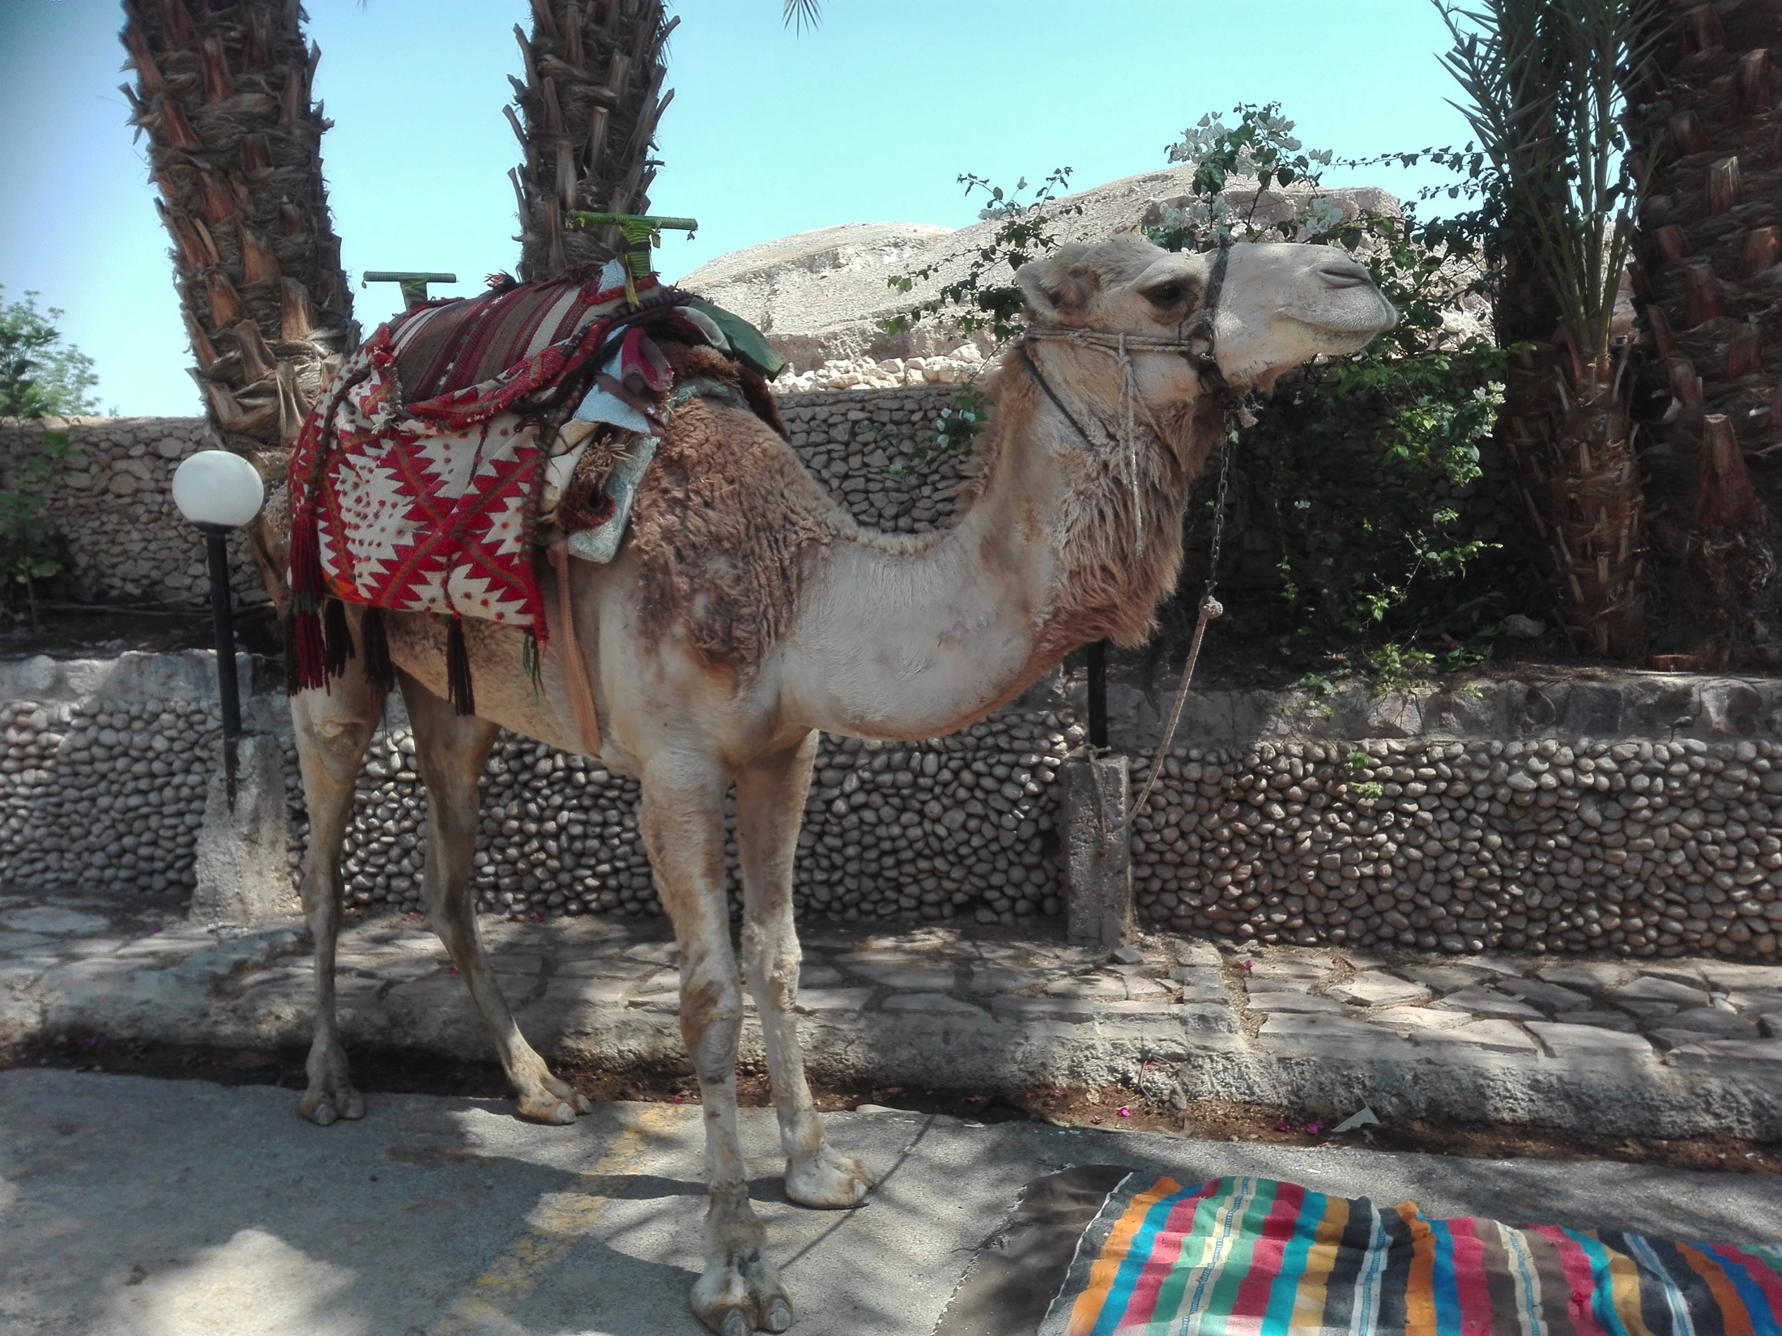
h.greenhalgh@xtra.co.nzh.greenhalgh@xtra.co.nz

Slide 3
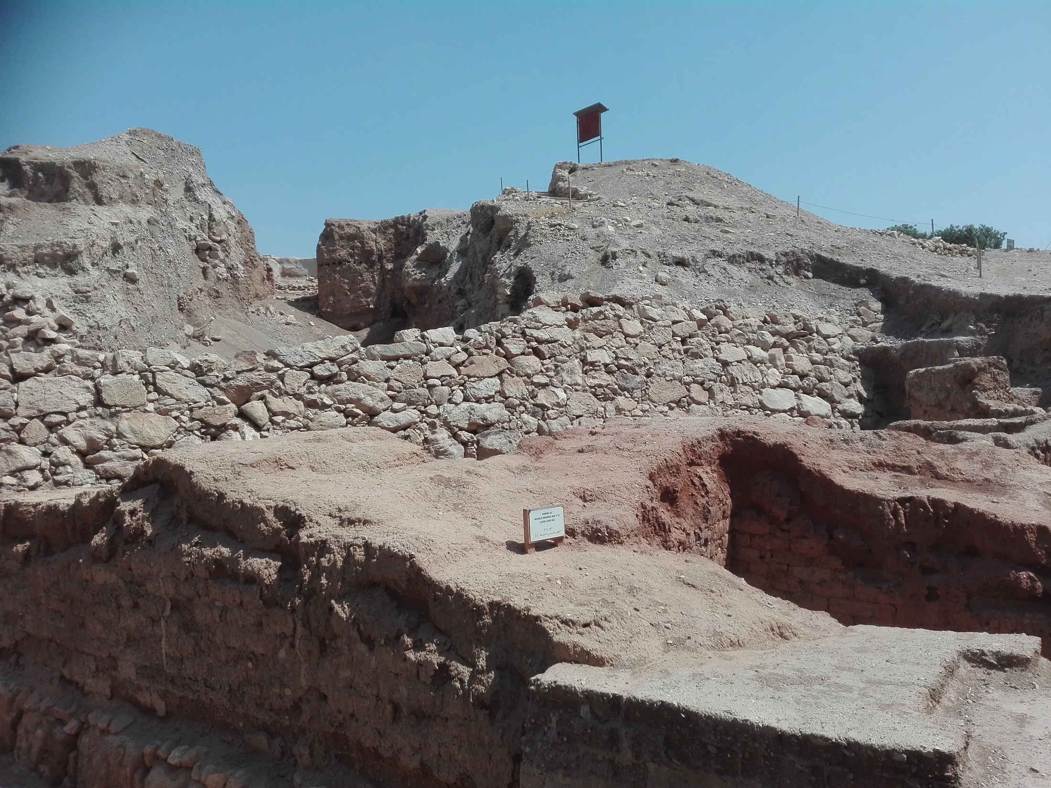
h.greenhalgh@xtra.co.nzh.greenhalgh@xtra.co.nz

Slide 4
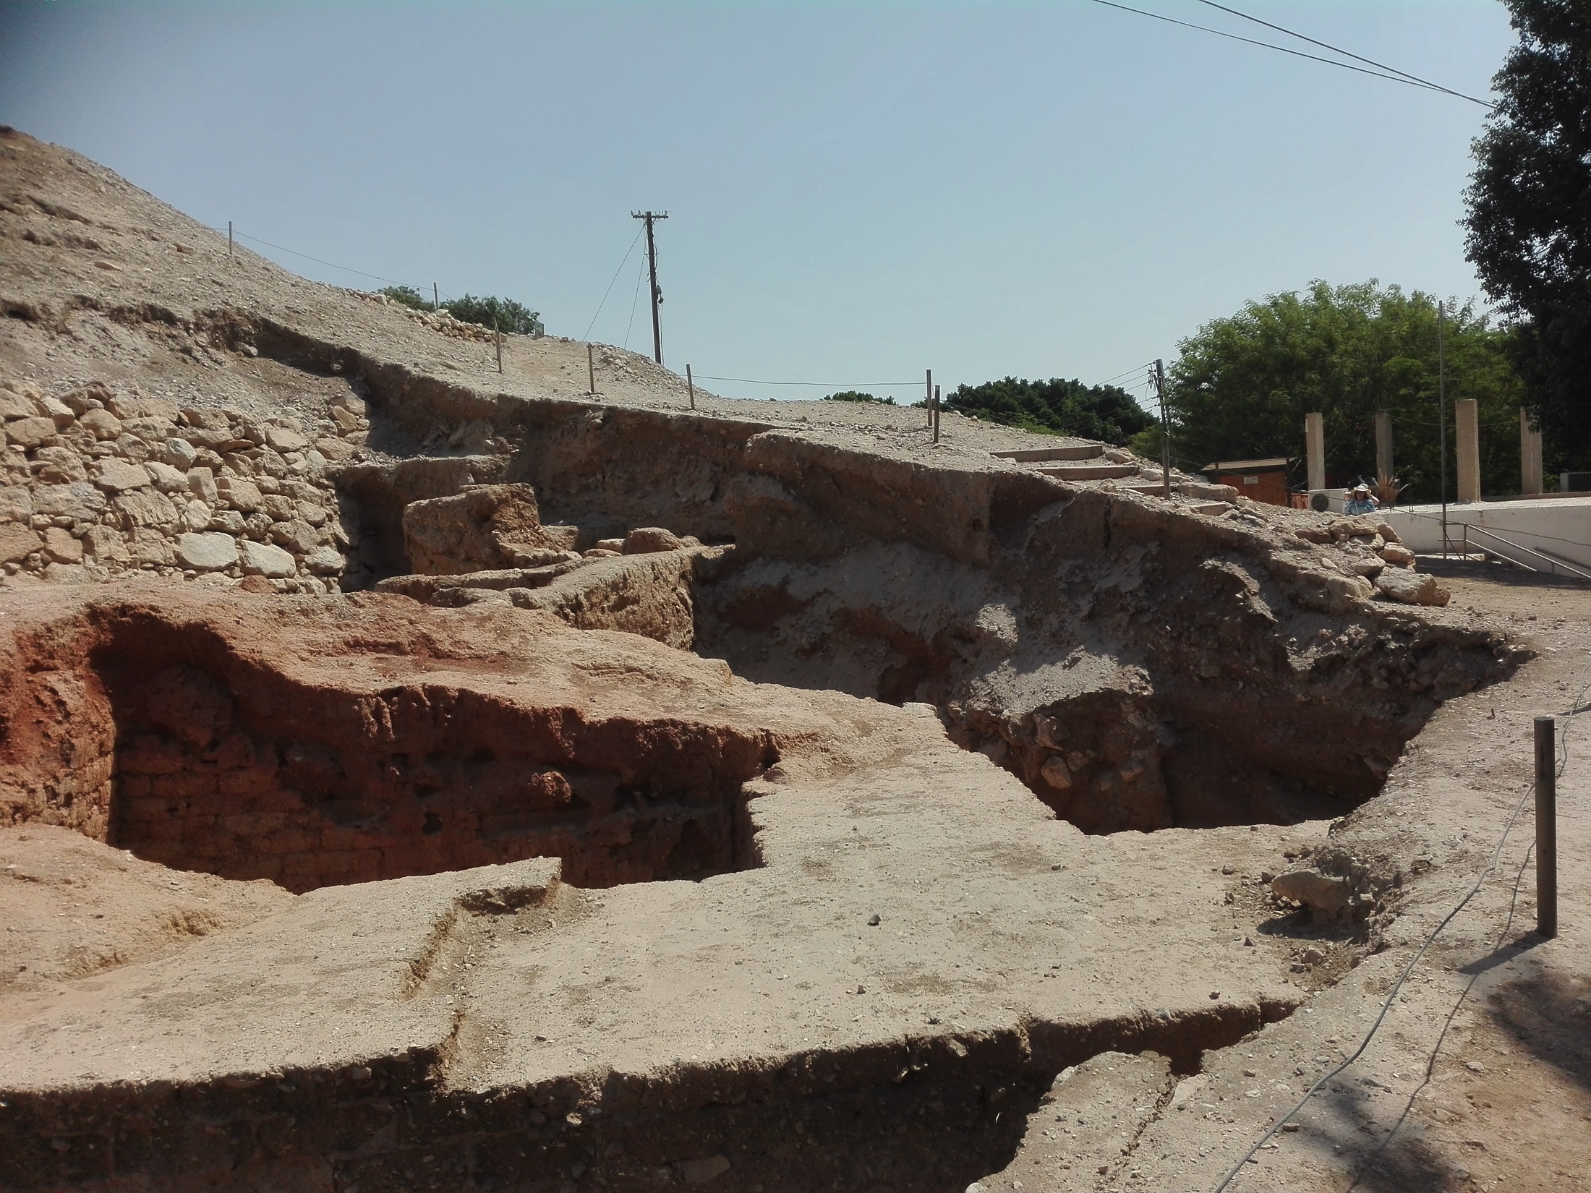
h.greenhalgh@xtra.co.nzh.greenhalgh@xtra.co.nz

Slide 5
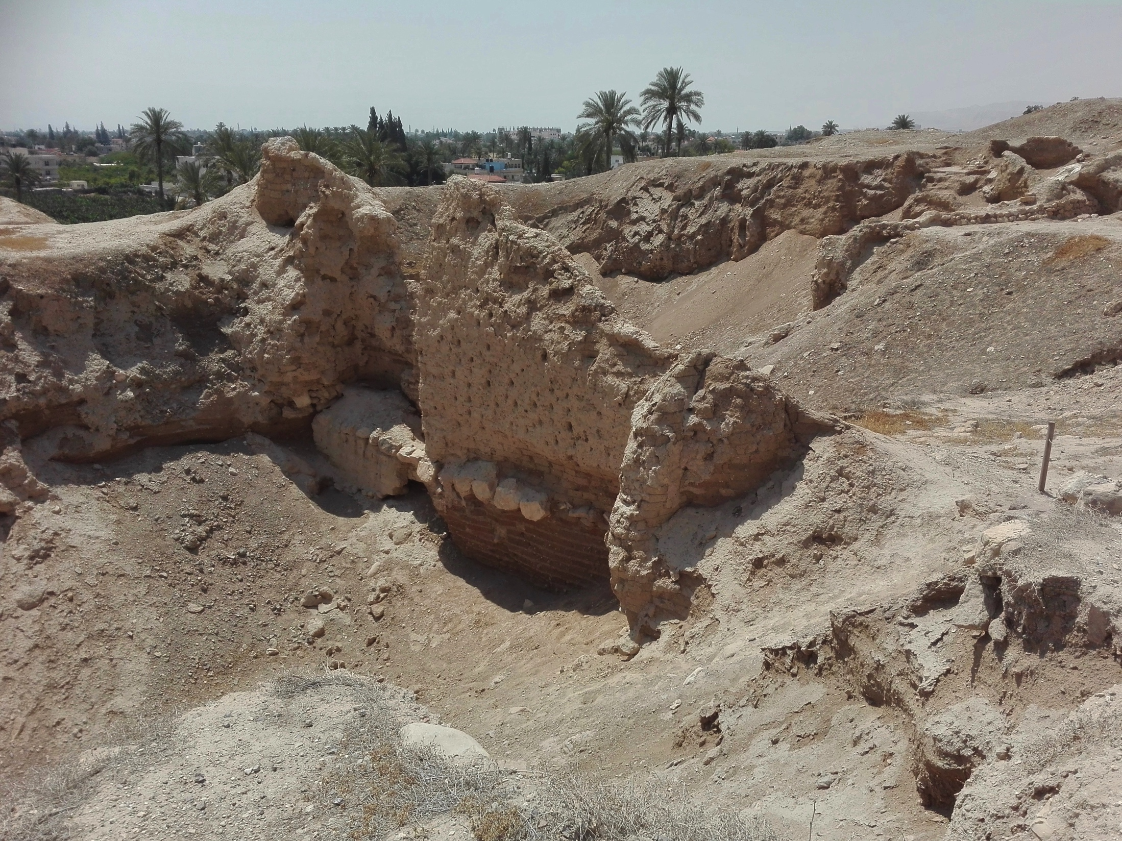
h.greenhalgh@xtra.co.nzh.greenhalgh@xtra.co.nz

Slide 6
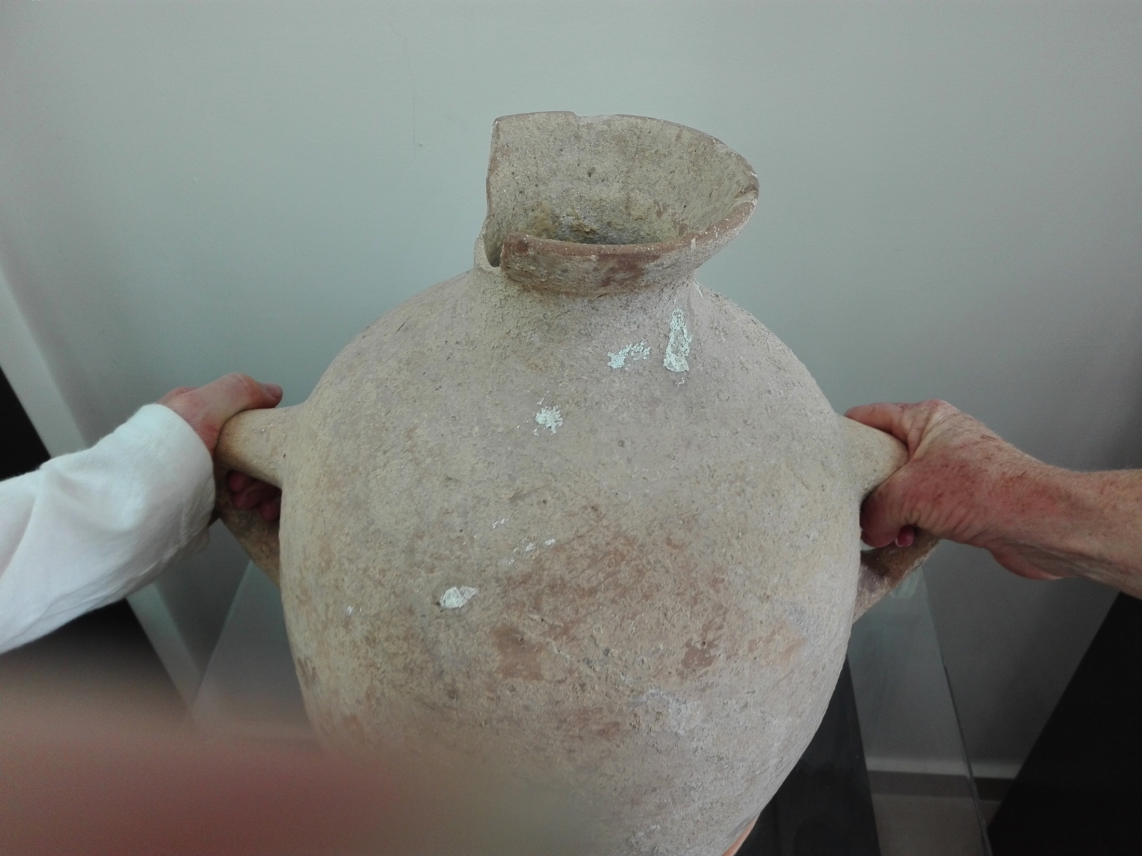
h.greenhalgh@xtra.co.nzh.greenhalgh@xtra.co.nz

Slide 7
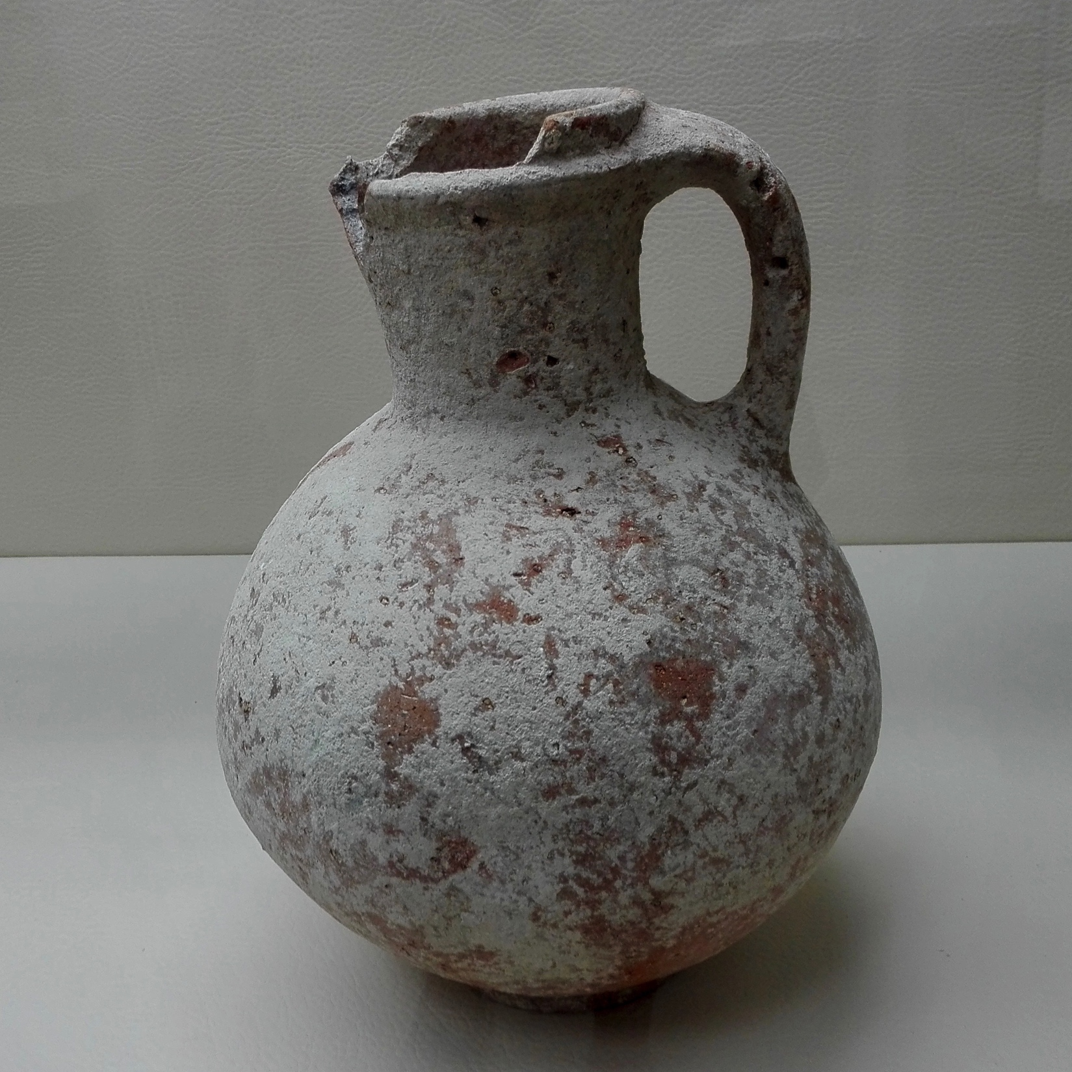
h.greenhalgh@xtra.co.nzh.greenhalgh@xtra.co.nz

Slide 8
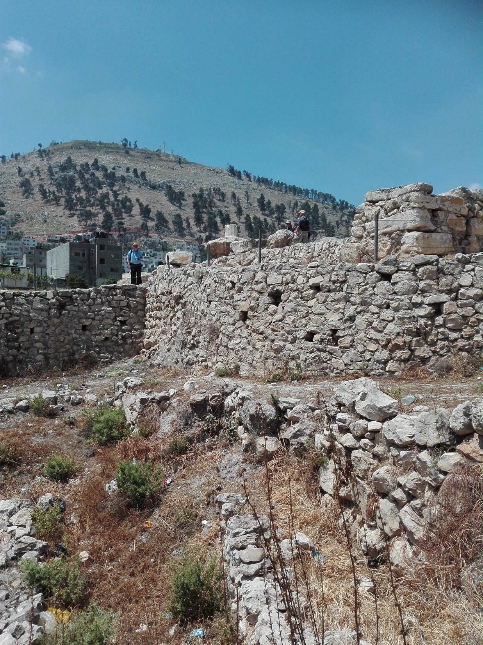

Slide 9
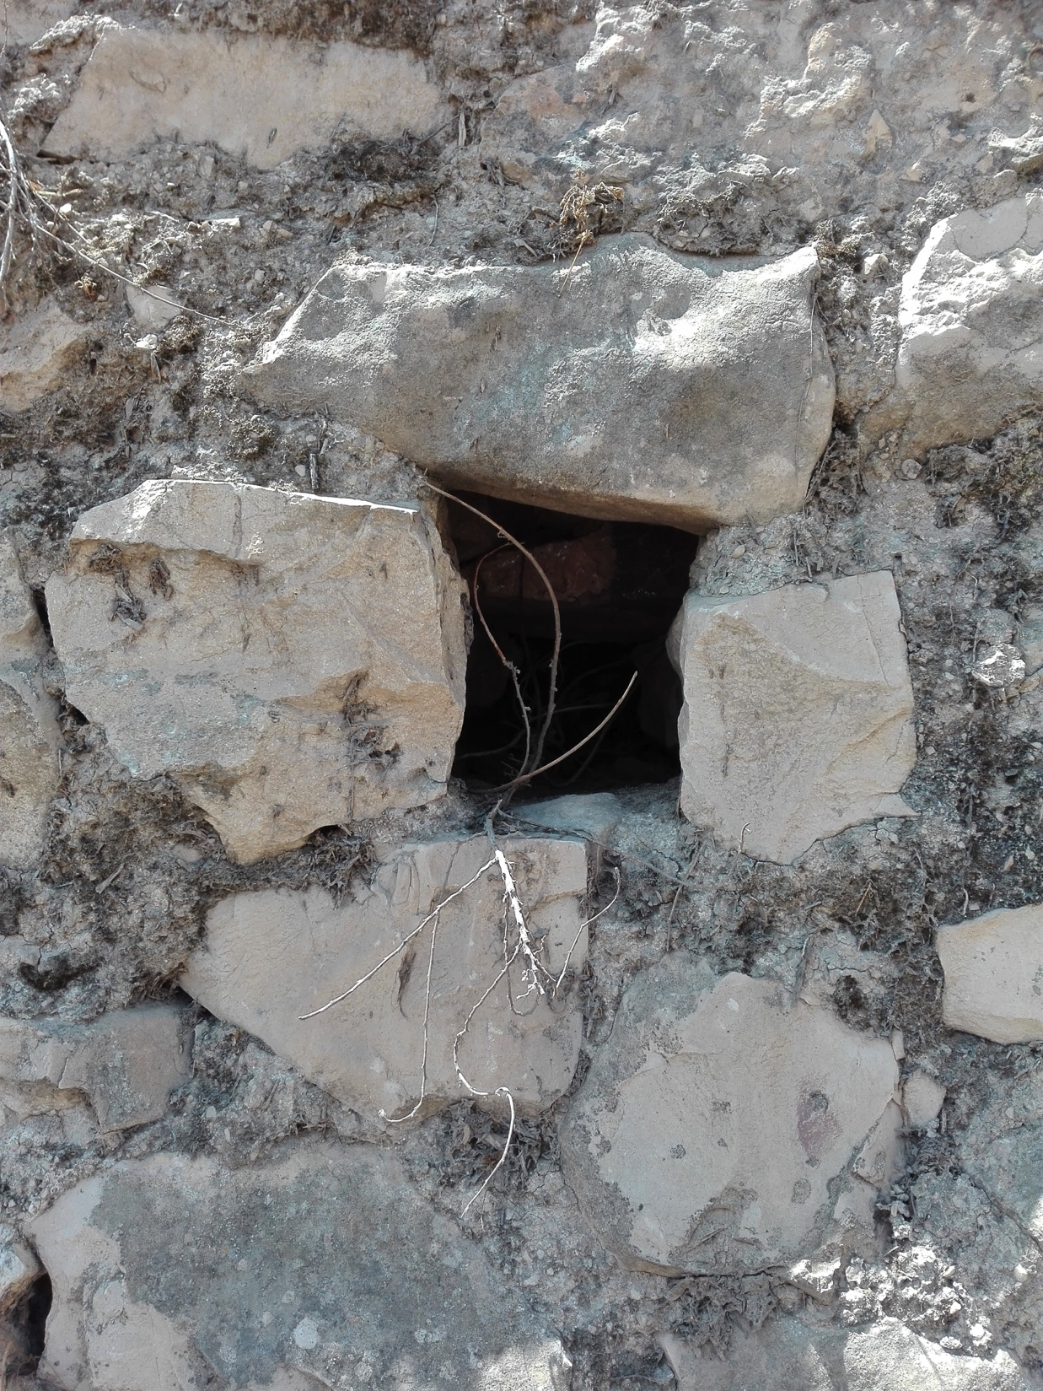

Slide 10
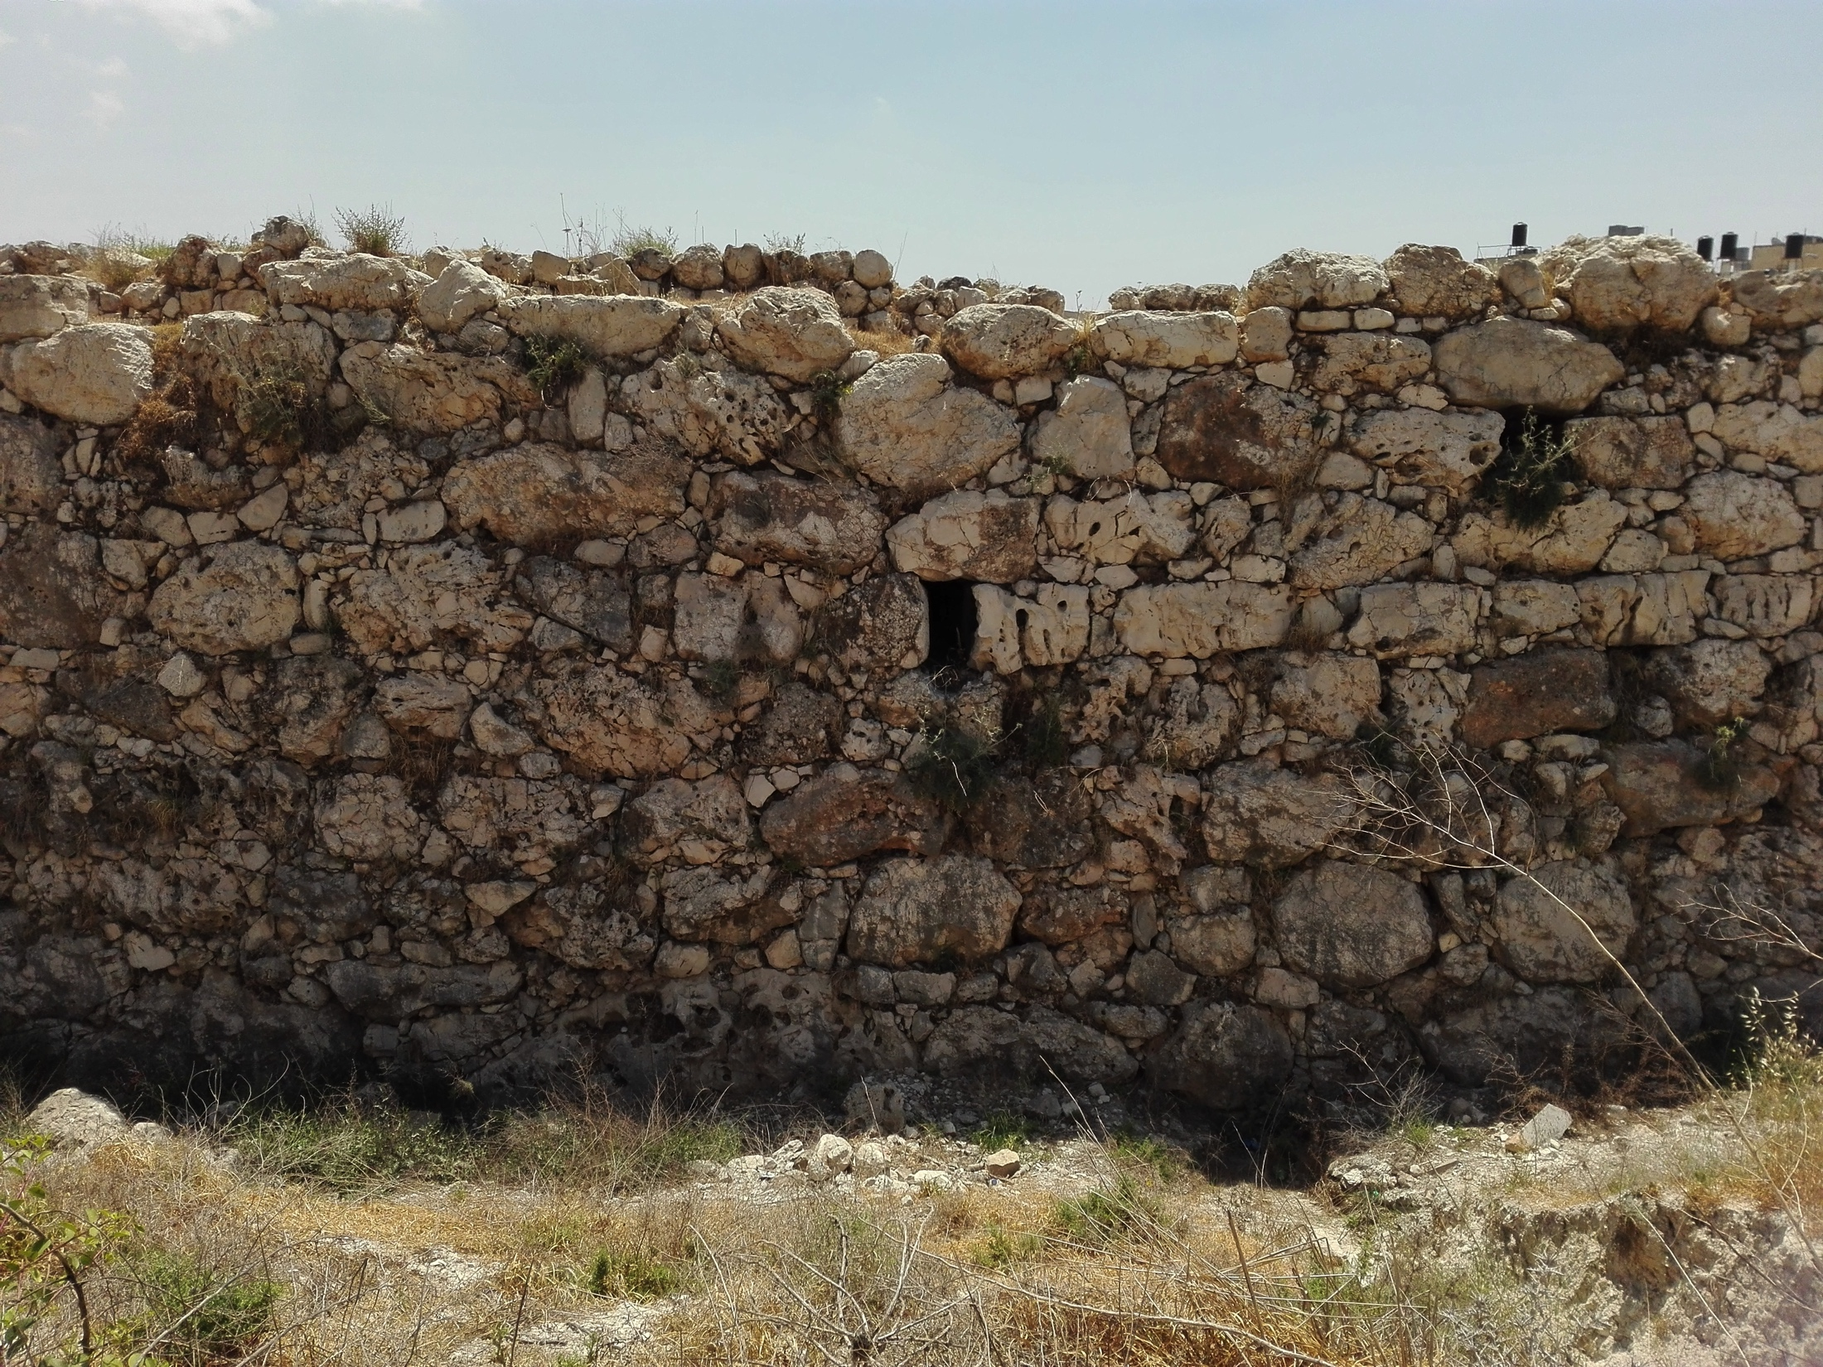
h.greenhalgh@xtra.co.nzh.greenhalgh@xtra.co.nz

Slide 11
h.greenhalgh@xtra.co.nzh.greenhalgh@xtra.co.nz

